Slide 1

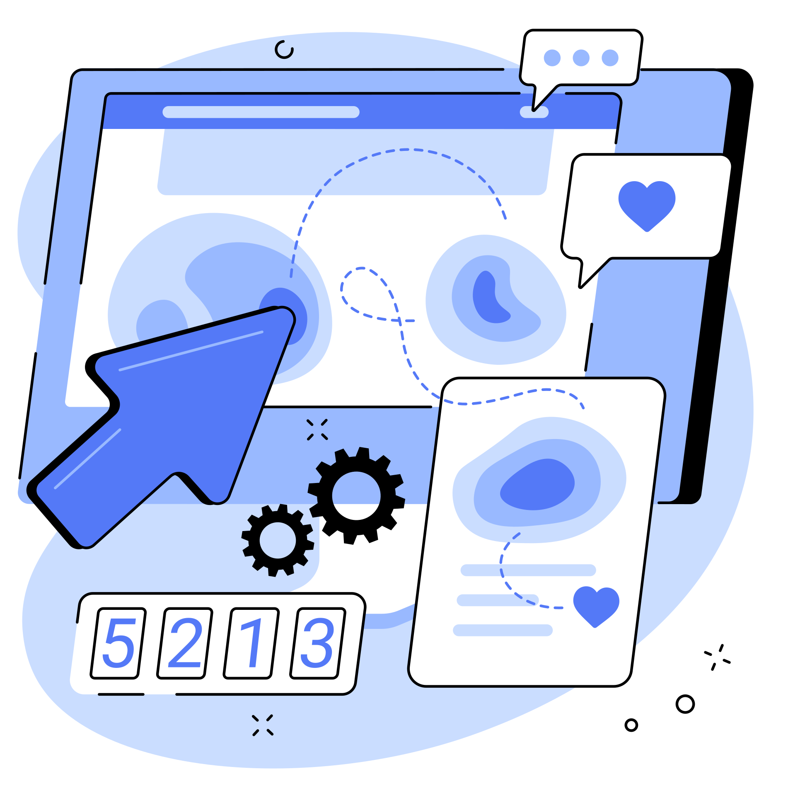


INTRODUCTION
SCREENSENSE
KIDS’ SCREENTIME VISUALIZATION PROJECT
Data-Driven Insights for Public Health Intervention
Student: Afzal Hussain S
Mentor: Sirisha
Role: Data Analytics Intern — Infosys Springboard 6.0
Timeline: 8 Weeks (Oct–Dec 2025)

Slide 2

PROBLEM
Why This Project Matters?
Indian children (ages 8–18) are experiencing rapidly increasing screen exposure.
Parents, educators, and policymakers lack clear data on:
How much screentime kids are actually consuming
Which groups are at highest risk
What devices and activities contribute most
What interventions could reduce health risks
PROJECT GOAL:
ransform raw screentime data into actionable insights for healthier digital habits.
2/10

Slide 3

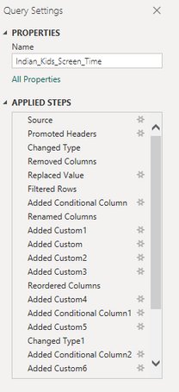
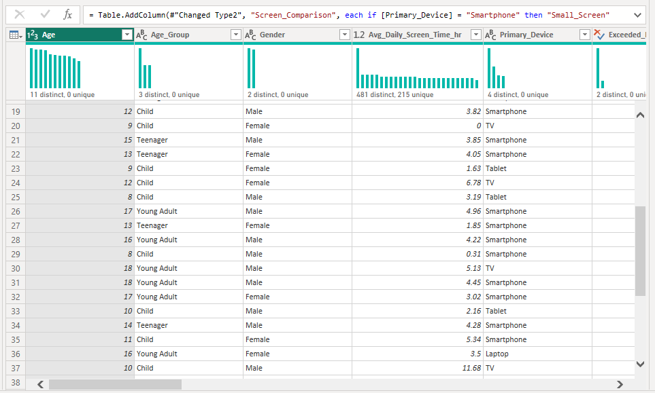

DATA FOUNDATION
Dataset Overview
Dataset: 9,712 Indian children (ages 8–18)
Feature Engineering (Milestone 1 & 2):
Age Bands (Child/Teen/Young Adult)
Urban/Rural Segmentation
Device Categories
Activity Types (Learning, Balanced, Entertainment)
Cohort Analysis
Usage & Health Indicator Columns
100% clean data, zero nulls
Source: Kaggle — Indian Kids
Screentime 2025
This foundation enabled deeper behavioral and health-pattern analysis.
3/10

Slide 4
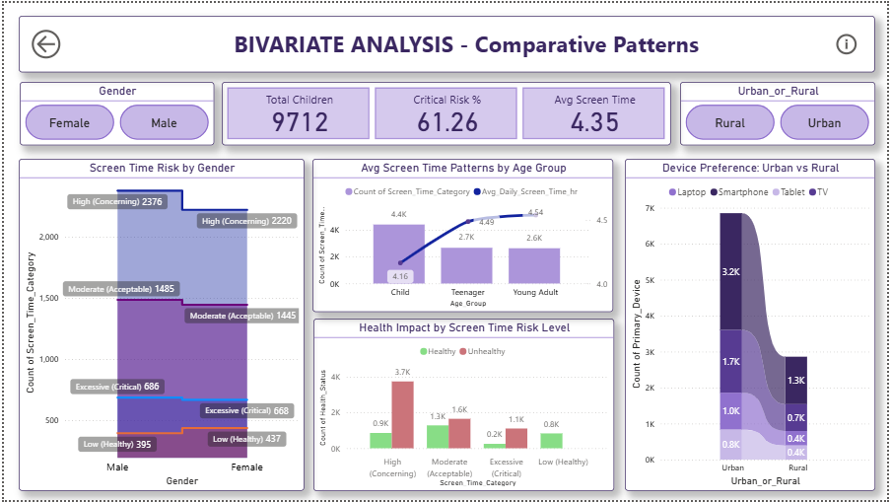
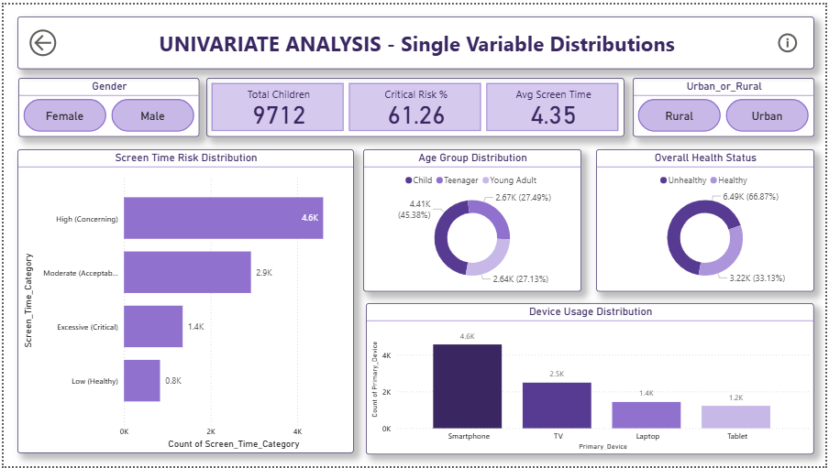
MILESTONE 2
Population-Level Findings
Avg daily screentime: 4.35 hours (recommended <2 hrs)
66.9% show at least one health issue
Health Impacts:
Young Adults: 7.8+ hours/day
Eye Strain: 67%
Poor Sleep: 63.2%
Anxiety: 58.2%
Obesity Risk: 61%
61.8% over recommended limit
Basically, 6 out of every 10 kids are unhealthy today, not in the future
4/10

Slide 5
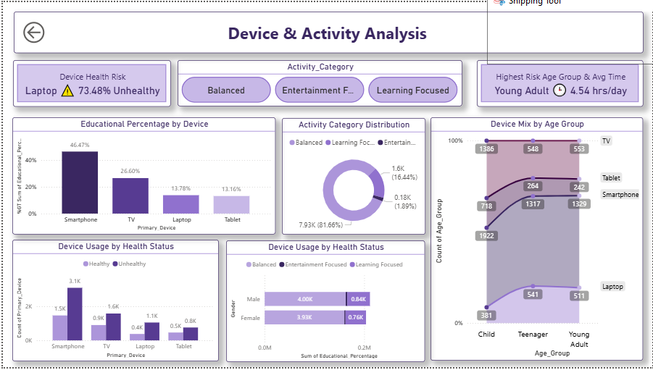


MILESTONE 2
Why activity & device matter?
For that, I compared activity types —
Learning vs Balanced vs Entertainment.
The results were brutally clear:
Entertainment kids → 68% unhealthy
Learning-focused kids → only 18% unhealthy
Smartphones are the worst — 68% unhealthy.
Laptops are the safest — just 4% unhealthy.
That’s a 50-point gap, just based
on what they watch.
Devices showed another huge
difference.
Small screen vs large screen alone creates a 23-point ergonomics gap
5/10

Slide 6

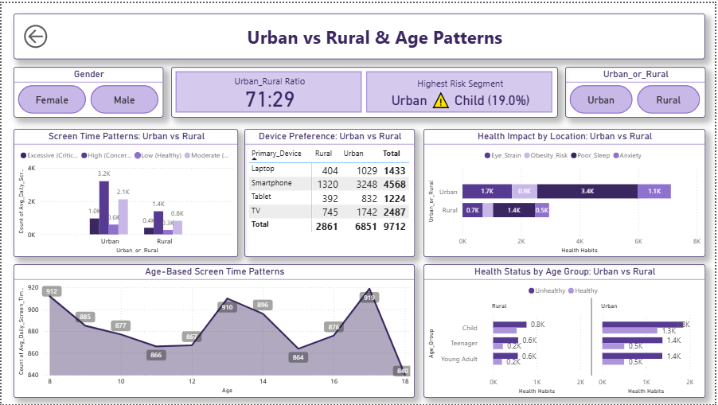
MILESTONE 2
Urban vs Rural Key Numbers
POPULATION SPLIT:
SCREEN TIME (AVERAGE):
Urban: 71%
Rural: 29%
Urban: Higher usage
Rural: Lower, but rising
RISK GROUP:
INTERVENTION FOCUS POINTS:
Urban - Child (27.0%)
Urban impact priority: Apps, School Programs
Rural impact priority: SMS, Awareness
Rural - Child (26.7%)
6/10

Slide 7
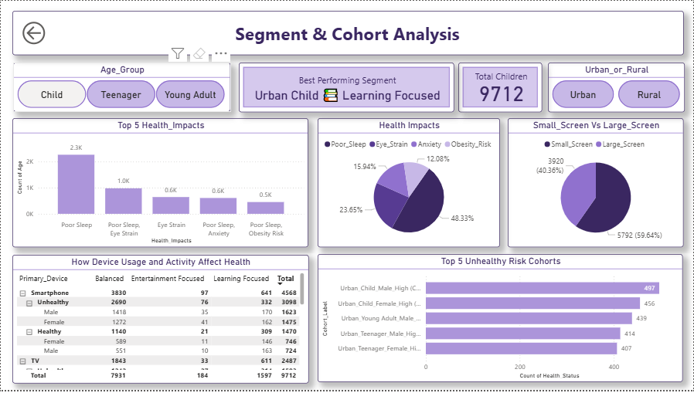
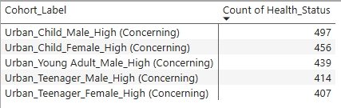
MILESTONE 3
Where the danger is concentrated?
I didn’t stop there. I wanted to know where exactly the risk is concentrated,
Turns out, 54% of the entire problem comes from just 5 groups.
All of them have one thing in common:
Common Patterns:
Entertainment-dominated usage
High smartphone dependence
Mostly urban environment
This means if you target just these groups, you can fix half the problem
7/10

Slide 8
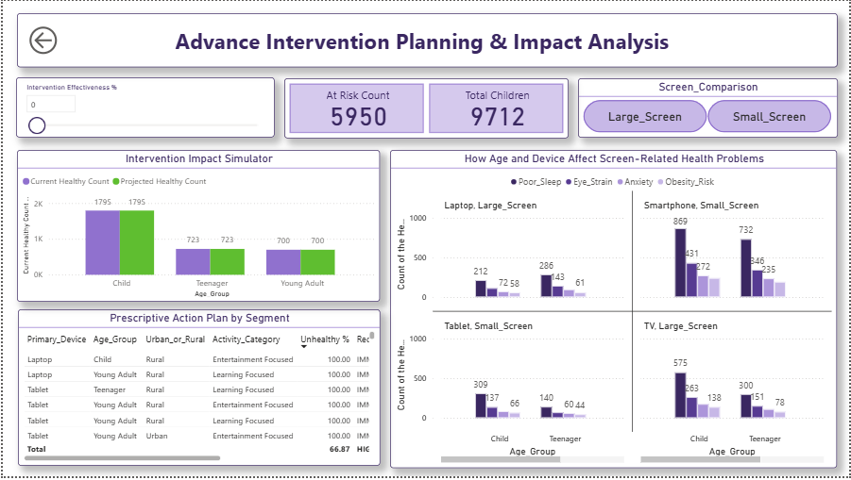
MILESTONE 3
Can this problem be fixed?
This is the part that actually surprised me —
When I simulated interventions using What-If parameters:
Current State
Healthy: 33.1% (3,222)
Unhealthy: 66.9% (6,490)
Intervention Effectiveness Breakdown
If we achieve even 60% effectiveness:
Healthy kids go from 33% → 70%.
With a blended strategy:
We can realistically reach 90.9% healthy.
Eg:
Parental Control Apps: 65% → 1,879 improved
School Programs: 58% → 1,818 improved
Rural SMS Campaigns: 48% → 1,379 improved
Device Recommendation: 35% → 3,399 improved
So yes — this is 100% fixable with the right approach
8/10

Slide 9
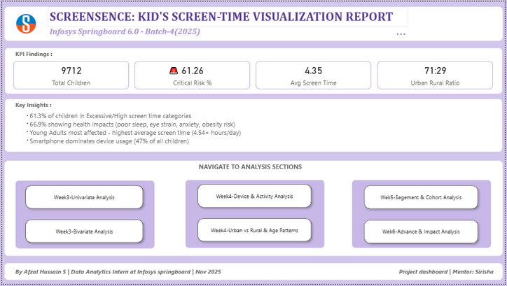
ARCHITECTURE
Dashboard Architecture
To support decision-making, I built a full 7-page dashboard:
Univariate & bivariate analysis
Activity-device interaction
Urban vs rural patterns
Cohort profiling
What-If simulator for intervention ROI
Intervention Effectiveness Breakdown
27+ visuals
15+ KPIs
Cross-filtering & slicers
Dynamic What-If parameters
Clean UX & color-coded risk indicators
This wasn’t just visualization — It’s a decision support system.
9/10

Slide 10

Recommendations
WHAT NEXT
Based on all findings, here are the strongest interventions:
Target: Urban Young Adults
Biggest measurable impact
Parental control apps for urban young adults
Promote large-screen usage
Low cost, high ROI
Device recommendation (shift from phone to laptop/TV)
School digital wellness programs
Target: 13–15 age group
Sustainable long-term impact
Rural SMS-based awareness
SMS-based nudges
Improves digital literacy
These four alone can shift 5,600+ kids into the healthy zone.
10/10

Slide 11

THANK YOU FOR YOUR ATTENTION!
So, what did this project achieve?
Identified a major national health issue
Pinpointed the exact groups to target
Measured the impact of multiple interventions
Built a professional 7-page dashboard
Demonstrated complete data → insights → strategy pipeline
And most importantly
This project converts raw data into real-world public health action.
Thank you
10/10

